Slide 1
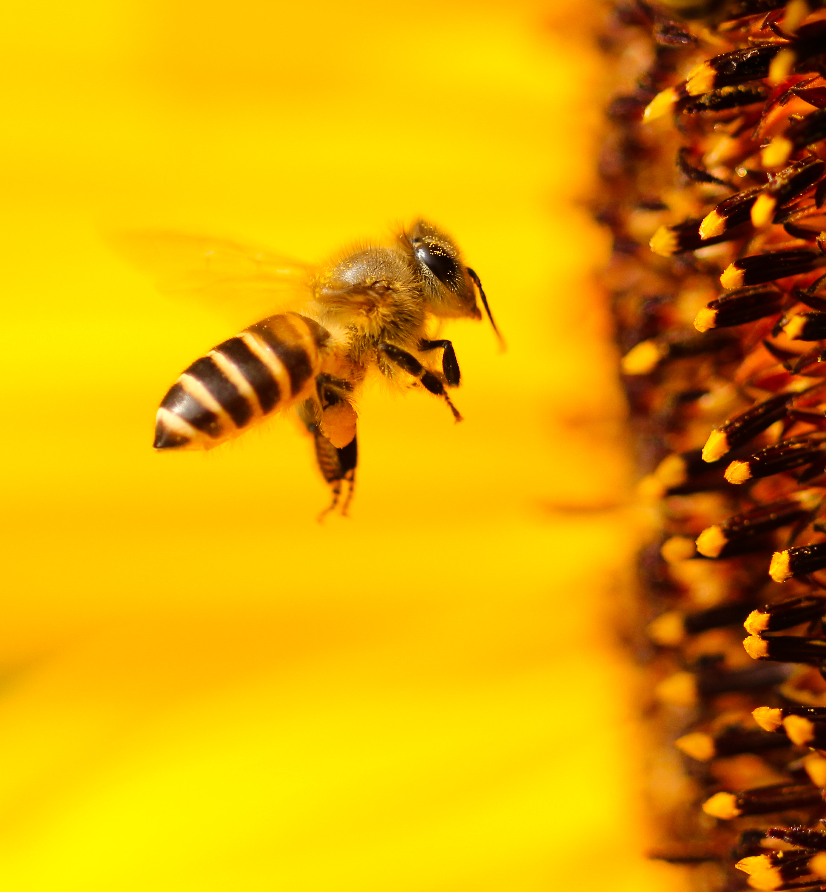
Honey in America
US Survey study 2018-2022
By Ram Catapang

Slide 2
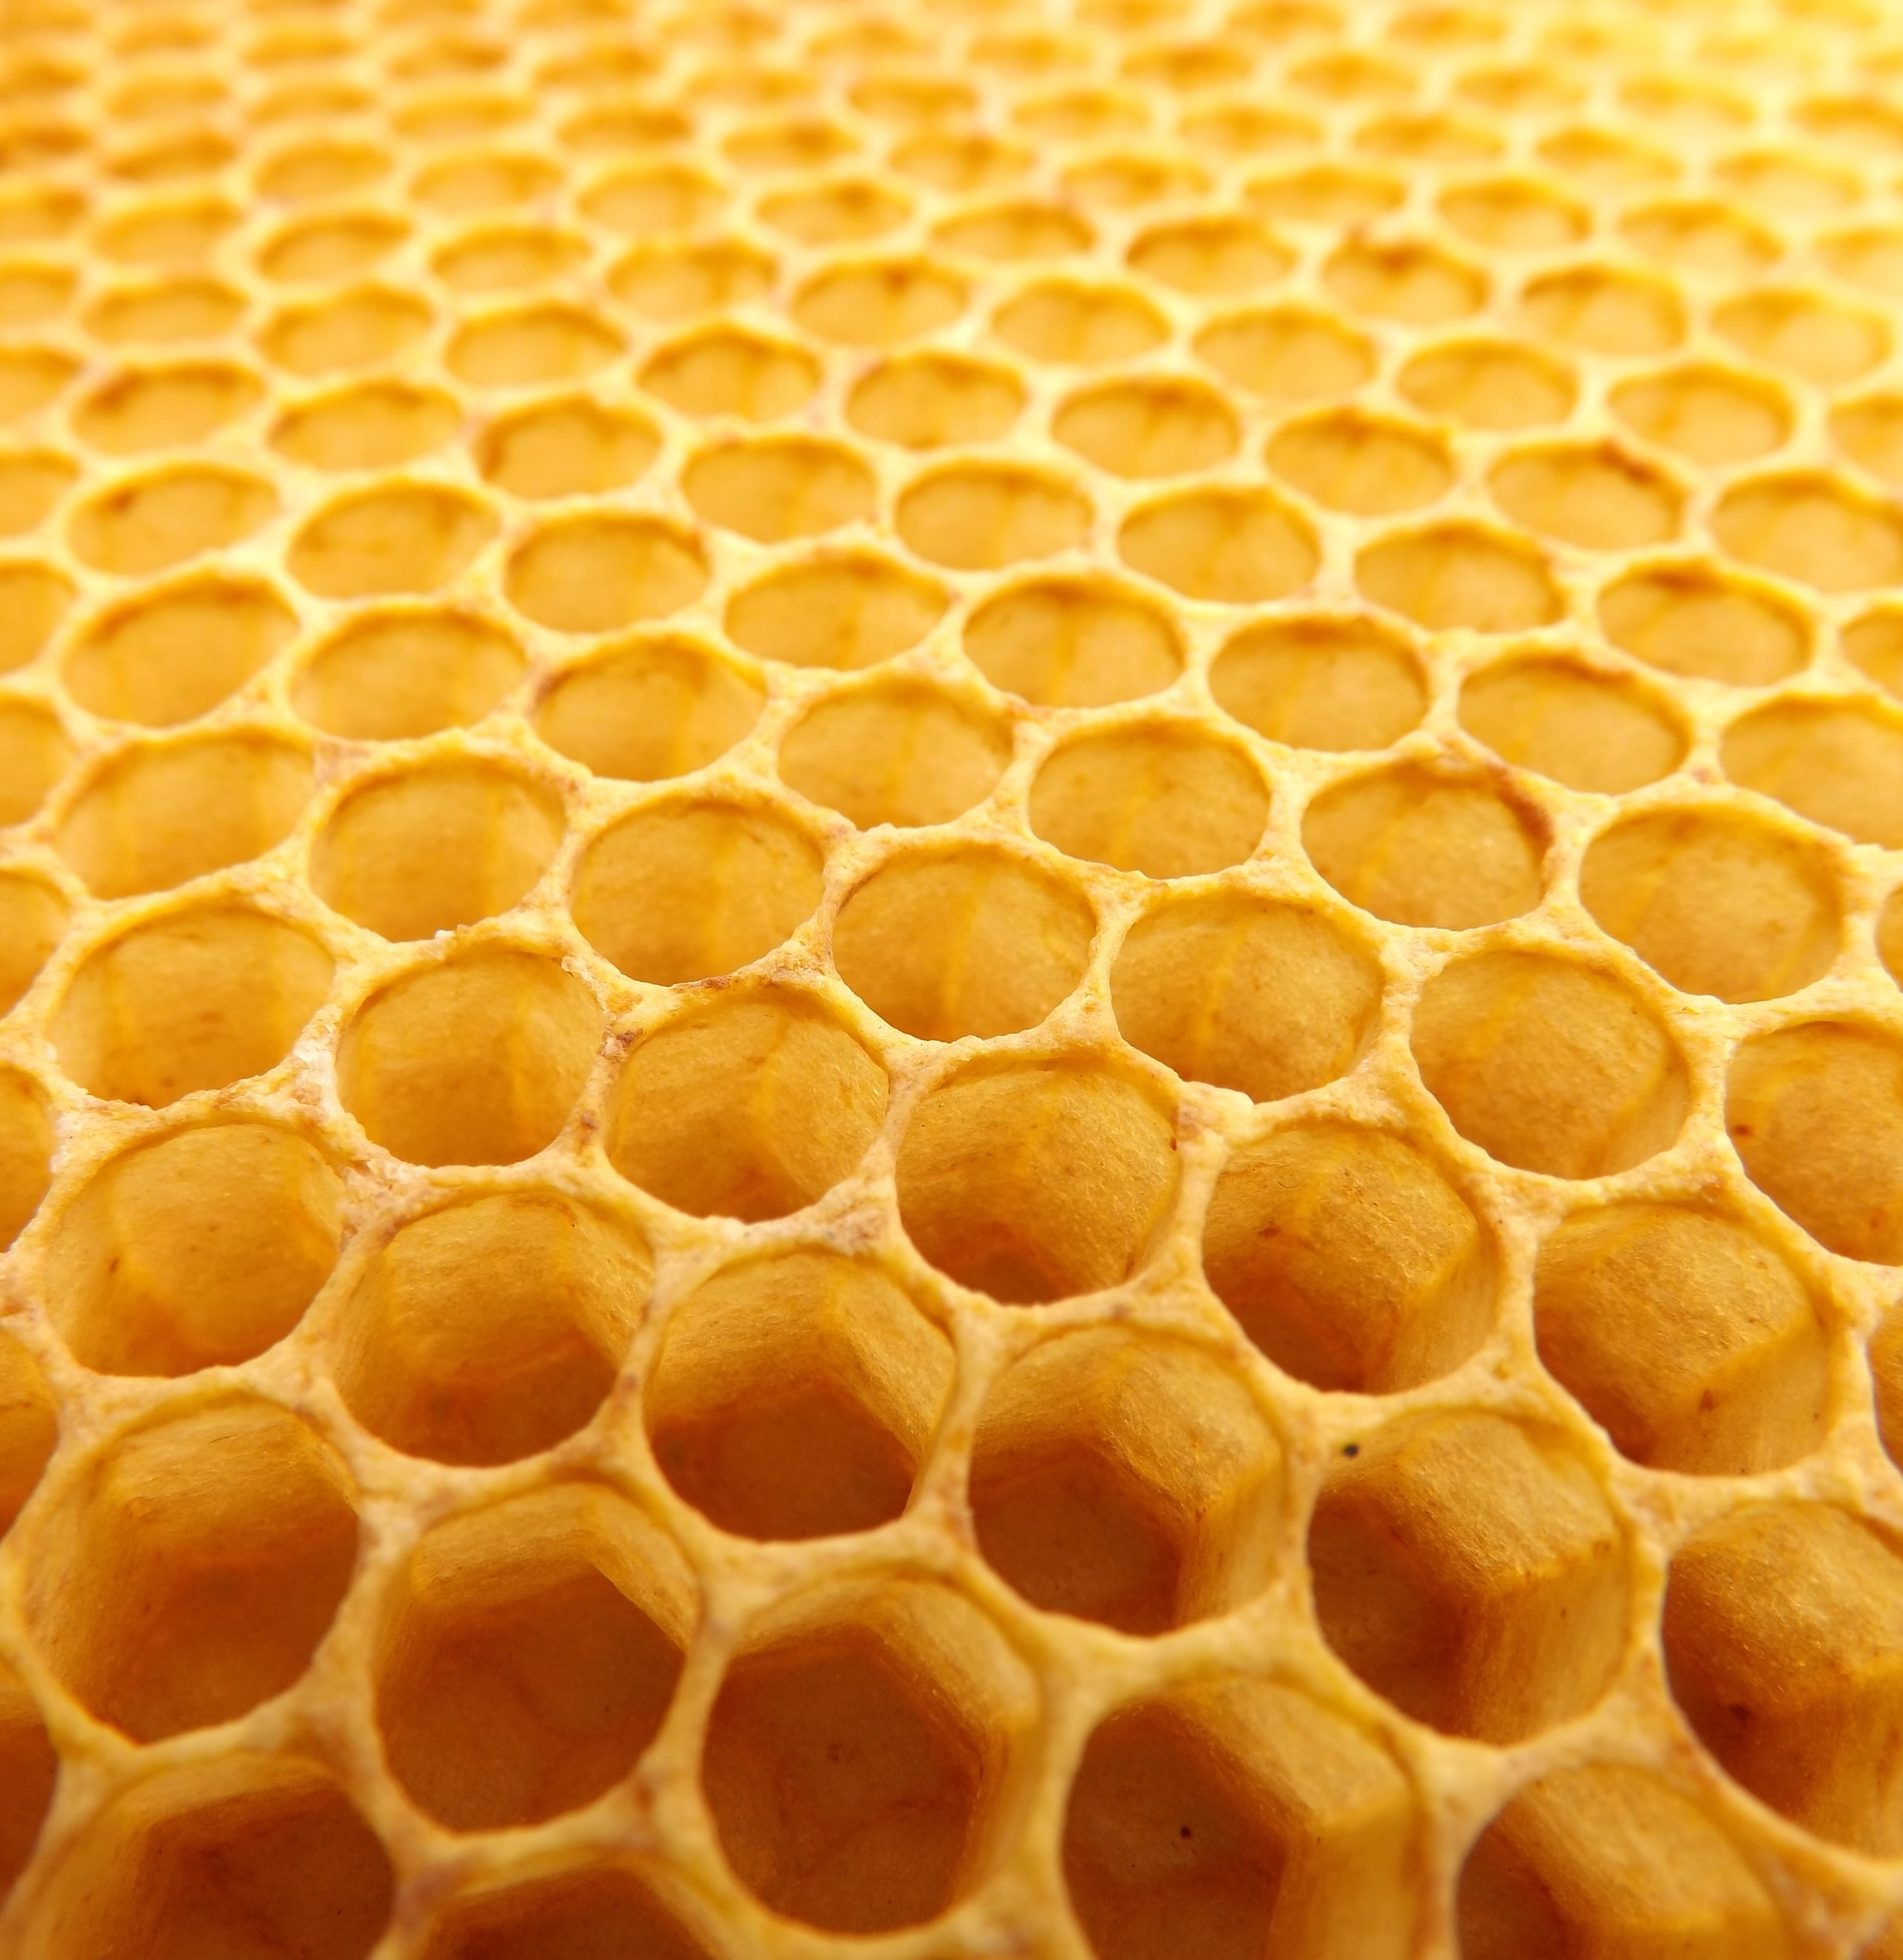
Contents
Question & hypothesis
Approach and analysis
Challenges
Question 1. Production and Cost
Question 2. Regional and State Production
Question 3. Effects of Colony Collapse Disorder
Results
Appendix

Slide 3
Question & Hypothesis
Does the volume of production have an influence on the cost of honey?
Hypothesis: Yes, Honey production and cost of production go hand in hand.
Which region produced the most honey from 2018 to 2022?
Hypothesis: Regions that are considered to be in the Great Plains will have the most honey production where wild flower nectar production would be denser for bee colonies.
In recent years, does CCD have a major impact on the production of honey?
Hypothesis: Yes, CCD has a major impact on the production of honey.

Slide 4
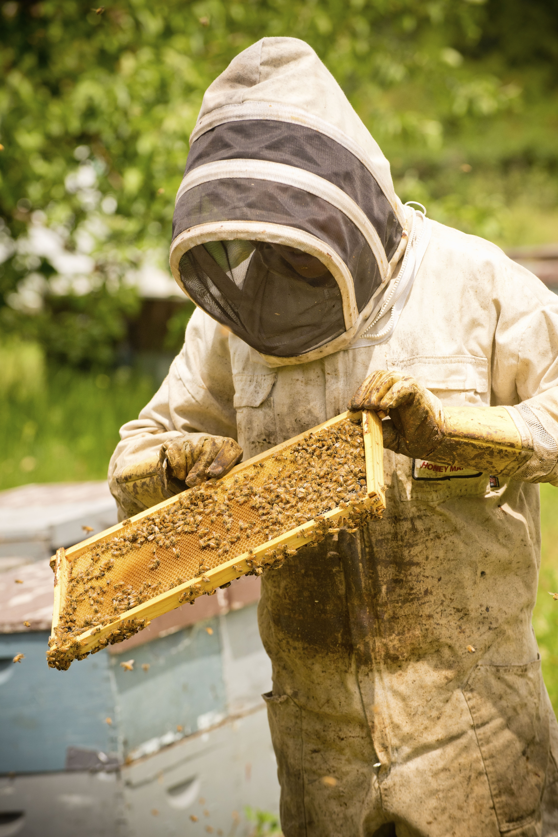
Approach & Analysis
Data was collected by USDA National Agricultural Statistic Services queried through Google BigQuery
Compiled, cleaned, and validated into one single dataset
The metrics State Name, Region (census.gov), Year, Volume, USD, Colonies, and CCD Colony Loss will be used to answer our questions
Analysis was done with statistical inference and visualization of the data obtained

Slide 5
Challenges
2018 Surveys for Colony Collapse Disorder were suspended by the USDA NASS due to budget requirements, limiting the year’s data to a singular US total
2022 Survey Data was not available on Big Query during the time of query. The data was added via the USDA NASS website

Slide 6
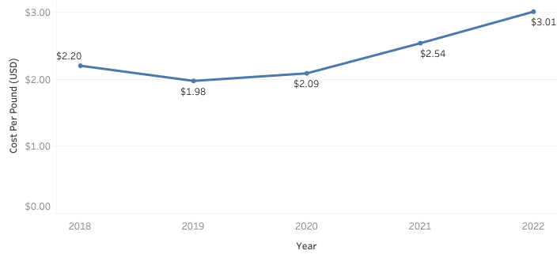
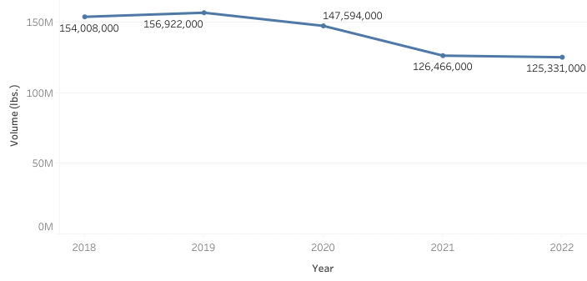
Question 1. Production and Cost
Average cost per pound year over year
Total honey production year over year
Since 2018, the production of honey decreased in 2022 by 18.62% over the four year timespan, while the average cost increased by 26.91% nationwide.

Slide 7
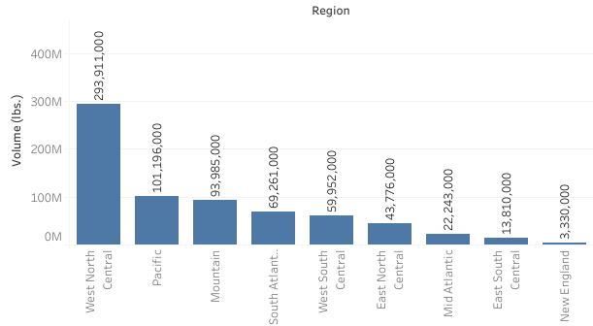
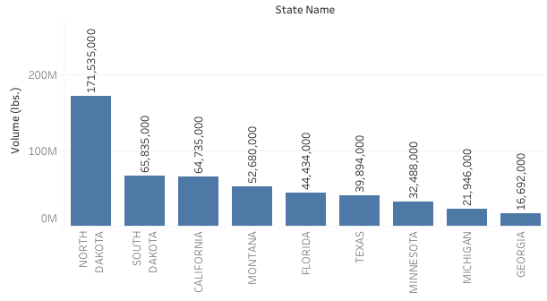
Question 2. Regional and State Production
Total Honey Production by region 2018 - 2022
Total Honey Production by State 2018 - 2022
The West North Central region was the largest regional producers of honey. North Dakota, producing 171,535,000 lbs., and South Dakota, producing 65,835,000 lbs., are the largest producers of honey among the states.

Slide 8
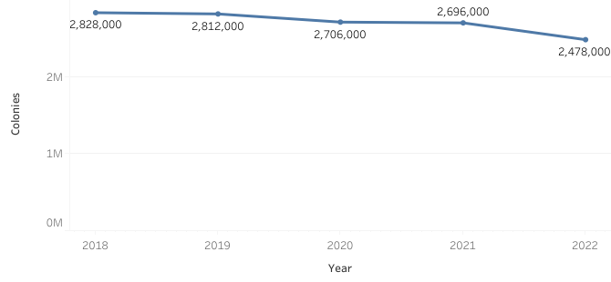
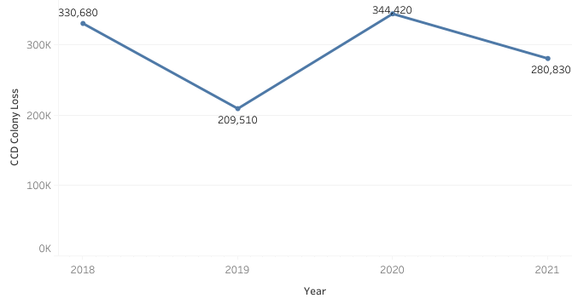
Question 3. Effects of Colony Collapse Disorder
Total Colonies year over year
Colony collapse disorder year over year*
From 2018 to 2021, Colony Collapse Disorder has affected colony population at an average of 10.57% each year.
*2022 Colony Collapse Disorder Report is expected Aug. 1, 2023. (USDA NASS)

Slide 9
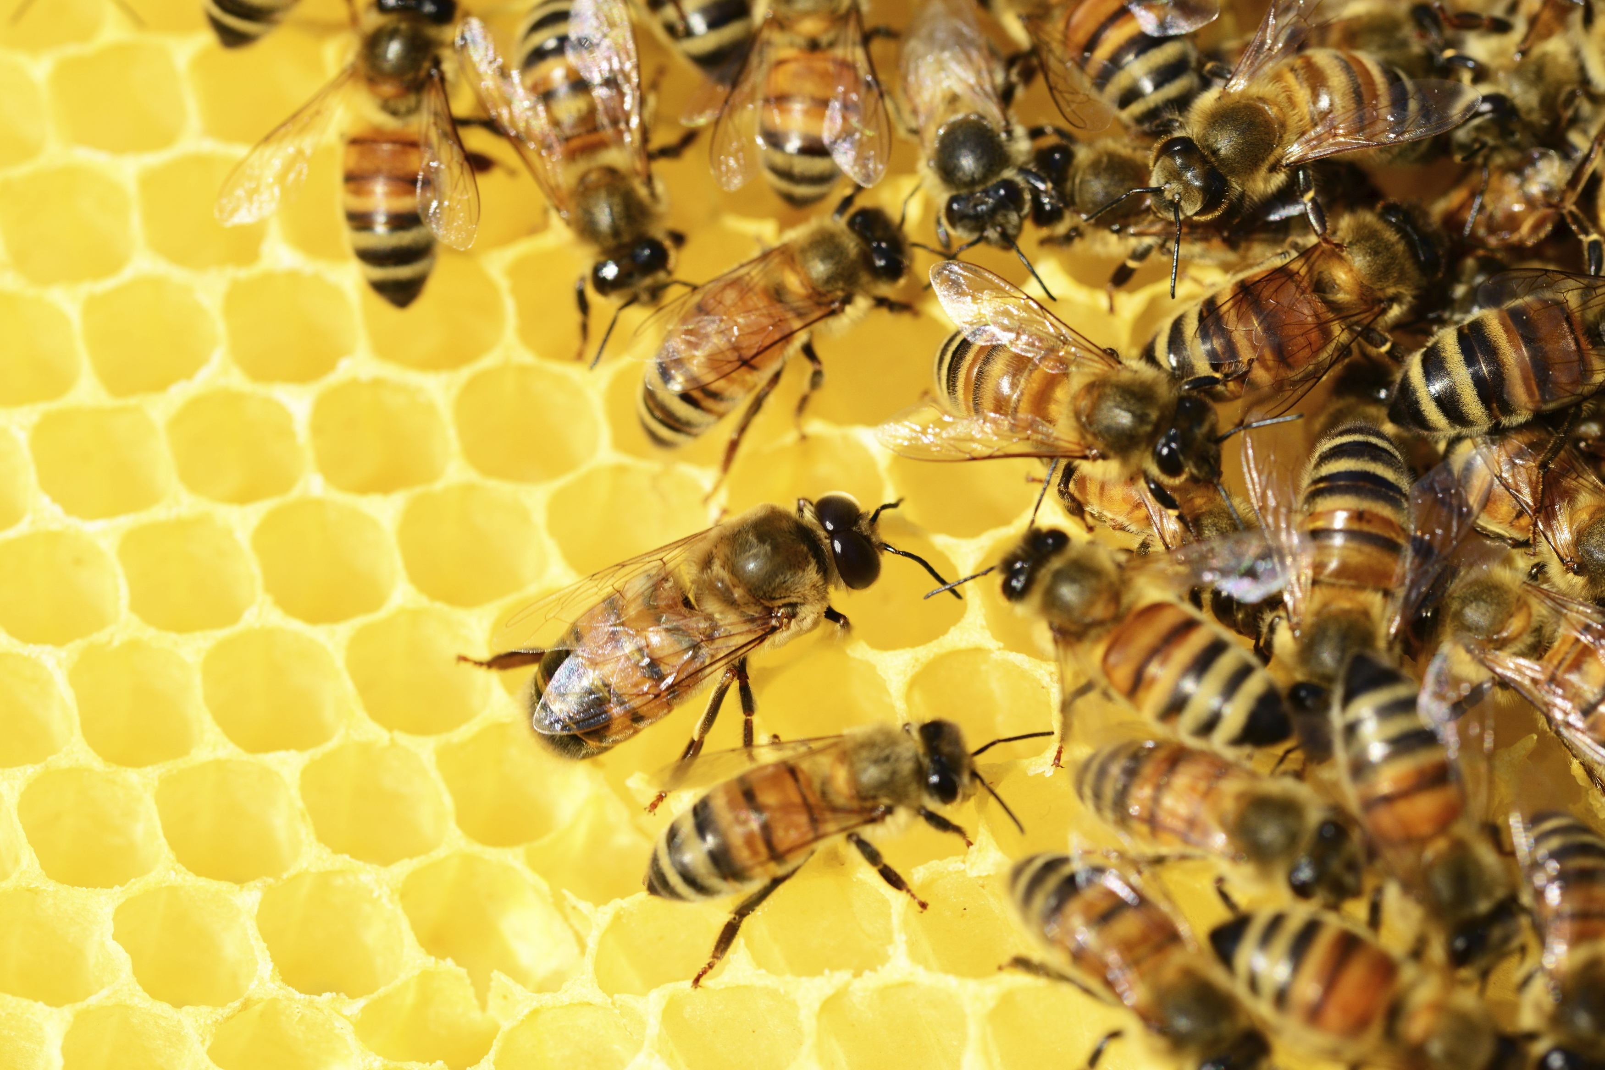
Results
Does the cost of honey have an influence on the volume of production?
Yes. Though economic inflation may be a major contributing factor in the average cost increase of 26.91% nationwide since 2018, the decreased supply of honey from 2020 influenced the most recent cost per pound of $3.01.
Which region produced the most honey from 2018 to 2022?
The West North Central region, which may be considered a part the of the Great Plains, produced the most honey from 2018 to 2022. More specifically, North Dakota is the largest honey producing state nationwide.
In recent years, does CCD have a major impact on the production of honey?
Though CCD accounted for an average 10.57% loss trending down in population from 2018 to 2021, there is no strong correlation to the decrease in production of honey or increase in cost.

Slide 10

Thank you.

Slide 11
Appendix
Survey data collected by USDA National Agricultural Statistics Service: https://www.nass.usda.gov/Surveys/Guide_to_NASS_Surveys/Bee_and_Honey/
Further analysis can be found on the projects Tableau dashboard: https://public.tableau.com/views/HoneyProductionperYear2018-2022/
Tools used for analysis: SQL, BigQuery, Microsoft Excel, Tableau, Microsoft Powerpoint

